Slide 1
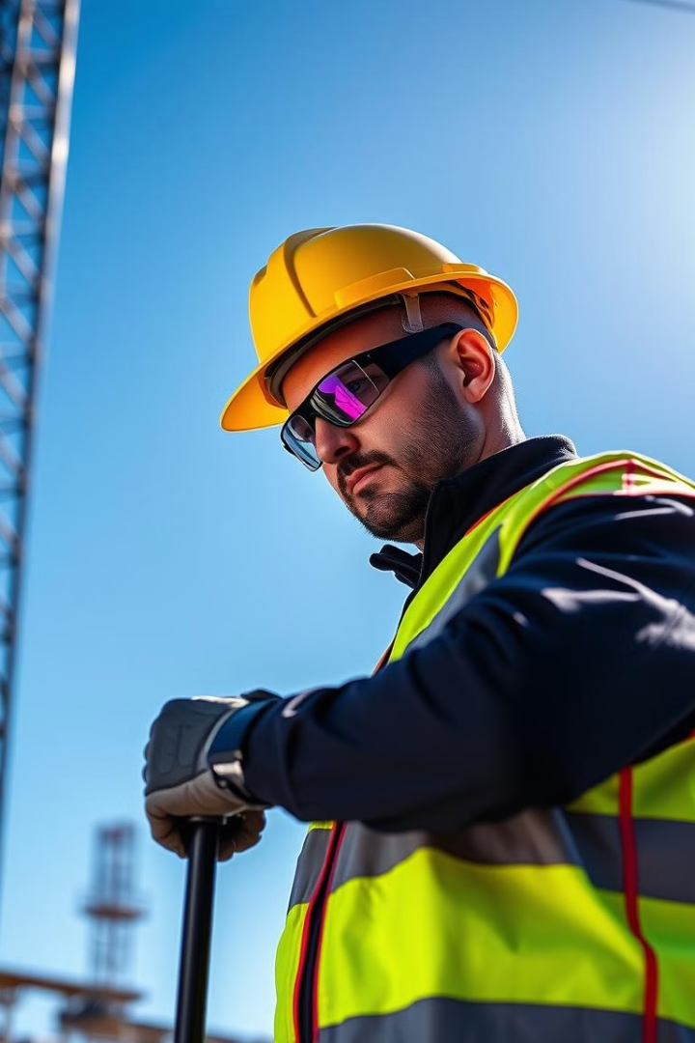
Object Detection for Safety Attire Using YOLO 5
This presentation outlines the use of the YOLOv5 algorithm for object detection, specifically focusing on identifying safety attire in various work environments.
by ElSAYED Sofy
ES

Slide 2
What is Object Detection?
Definition
Applications
Object detection is a computer vision task that involves identifying and locating objects within an image or video. This technology is crucial for various applications.
Object detection plays a critical role in autonomous driving, medical imaging, security systems, and many other fields.

Slide 3
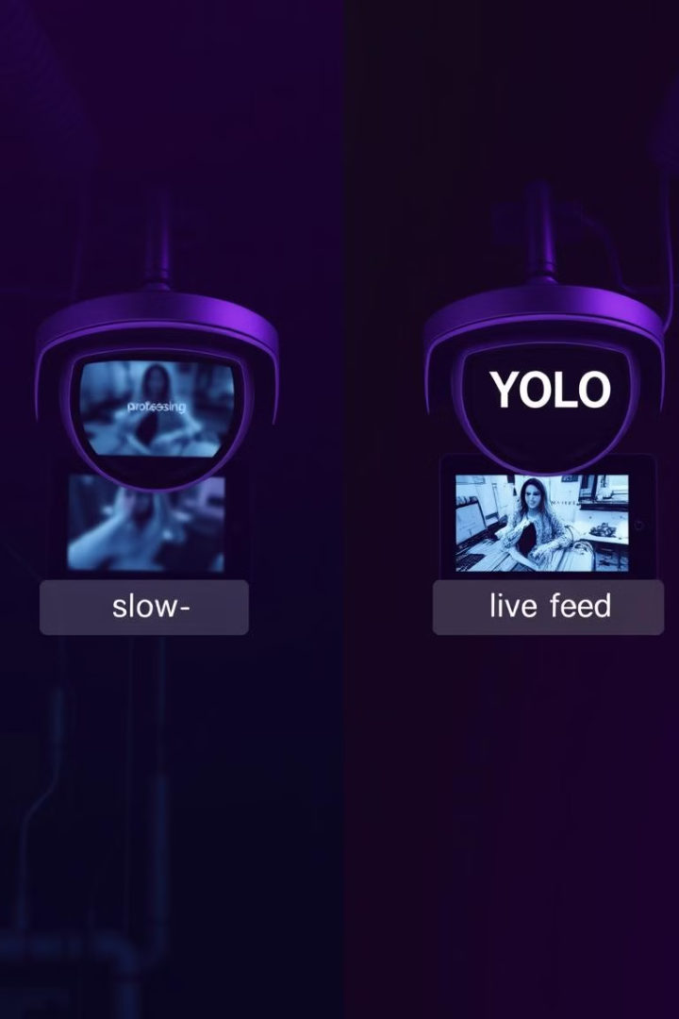
Why YOLO Algorithm Matters
1
Speed
2
Accuracy
YOLO is known for its speed and efficiency, making it suitable for real-time applications.
YOLOv5 delivers high accuracy in object detection, achieving impressive results in identifying objects in complex scenes.
3
Versatility
The YOLO algorithm is versatile and can be adapted to detect a wide range of objects, including safety attire.

Slide 4
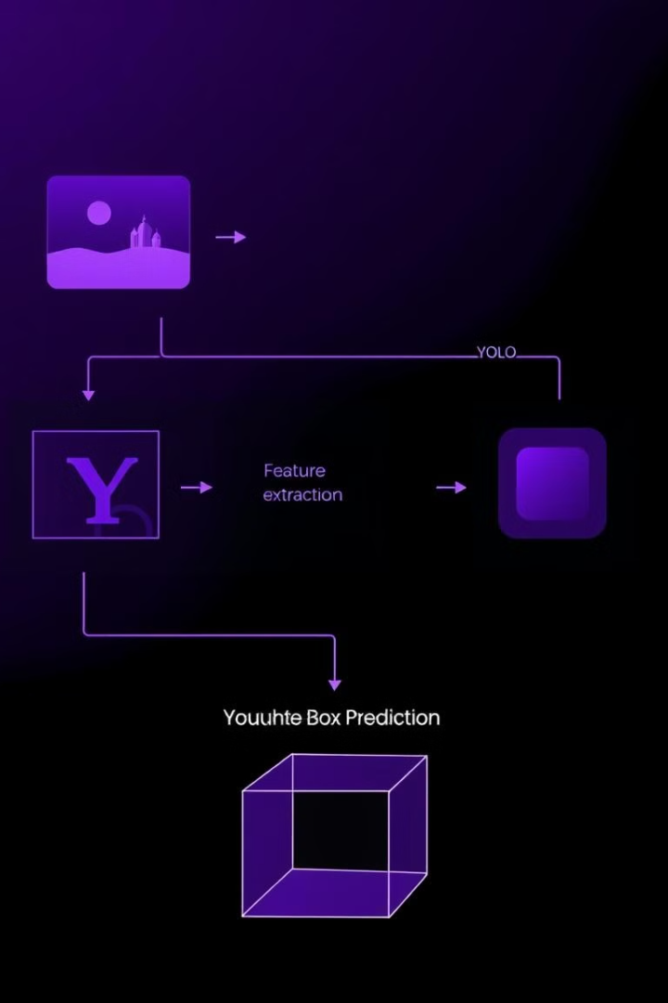
How YOLO Algorithm Works
1
Input
The YOLO algorithm takes an image as input and divides it into a grid.
2
Feature Extraction
The model extracts features from the image using convolutional neural networks.
3
Bounding Box Prediction
The algorithm predicts the bounding box coordinates and class probabilities for each object.

Slide 5
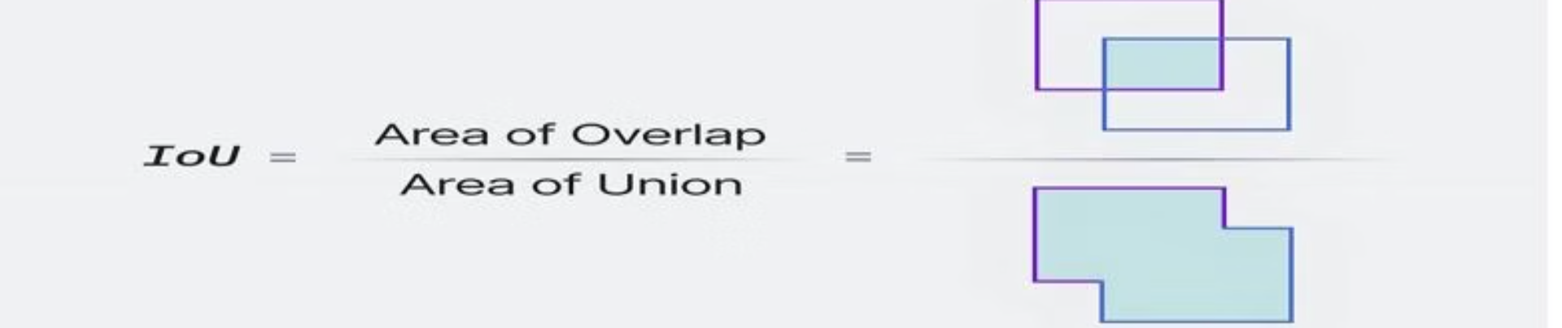


Intersection over Union (IOU)
Measurement
Evaluation
IOU is a metric used to evaluate the overlap between a predicted bounding box and the actual ground truth bounding box.
A higher IOU score indicates a better prediction and a more accurate object detection model.

Slide 6
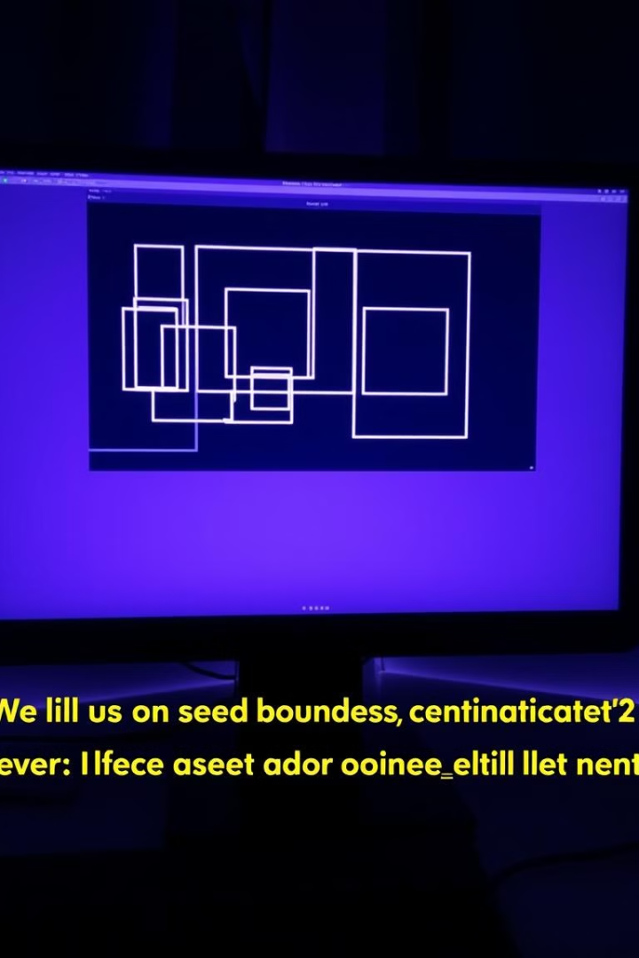

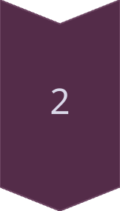
Non-Maximum Suppression (NMS)
Purpose
NMS is a technique used to eliminate redundant bounding boxes, selecting only the best prediction for each object.
Process
NMS iterates through the bounding boxes, suppressing those with lower confidence scores while keeping the boxes with the highest scores.

Slide 7



Collecting Data (Roboflow)
Data Collection
1
The first step is to collect a dataset of images containing objects of interest, like safety attire.
Annotation
2
Using a tool like Roboflow, these images are annotated with bounding boxes around the objects.
Dataset Preparation
3
Roboflow processes and prepares the data, generating a dataset suitable for training.

Slide 8
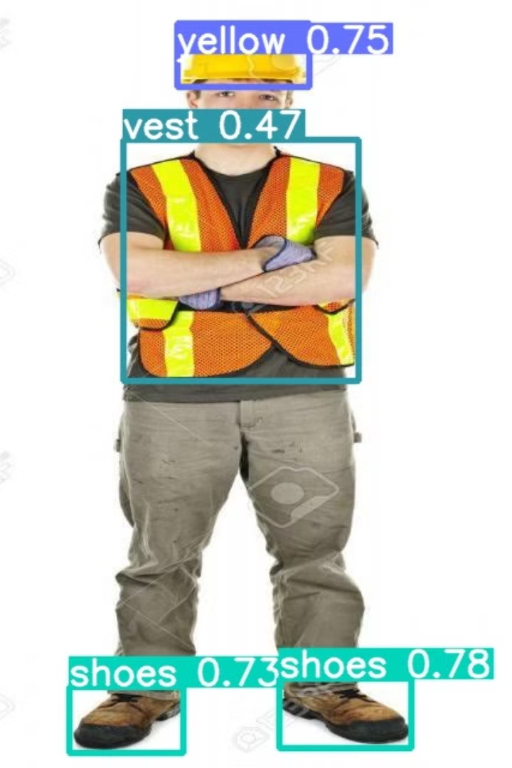
Evaluation and Performance Analysis
78.8%
63.0%
Precision
Recall
The model's ability to correctly identify safety attire objects.
The model's ability to detect all instances of safety attire.
95%
Accuracy
An overall measure of the model's performance.

Slide 9
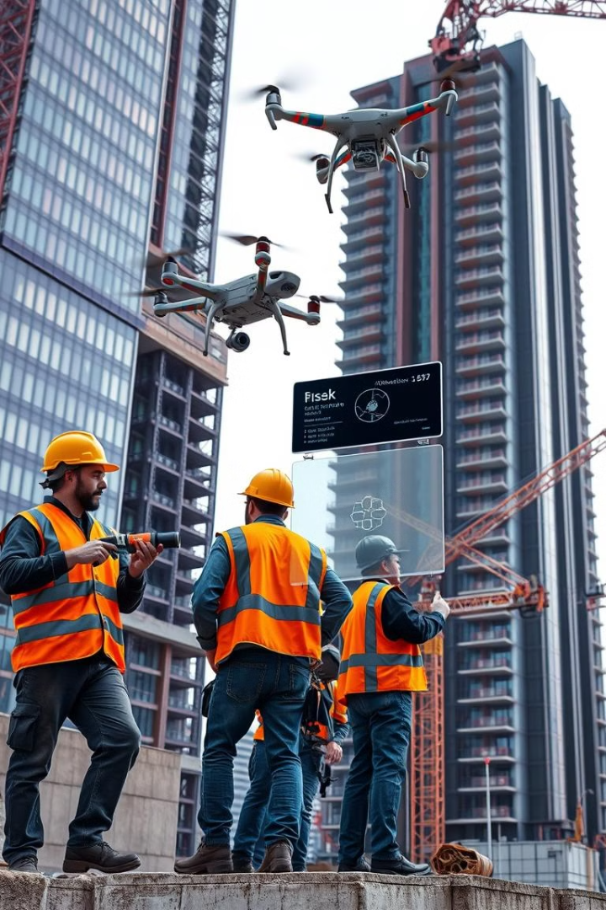
Conclusion and Future Directions
YOLOv5 has emerged as a powerful tool for object detection, enabling real-time safety monitoring in various industries. Future research could explore the integration of YOLOv5 with other AI technologies to enhance safety procedures and improve the accuracy of object detection.

